Slide 1
United International University
Computer Networks Laboratory
CSE 3712
Md. Muhyminul Haque
Mail: muhyminul@cse.uiu.ac.bd

Slide 2
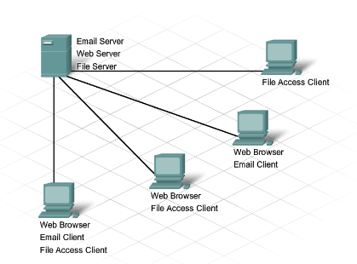
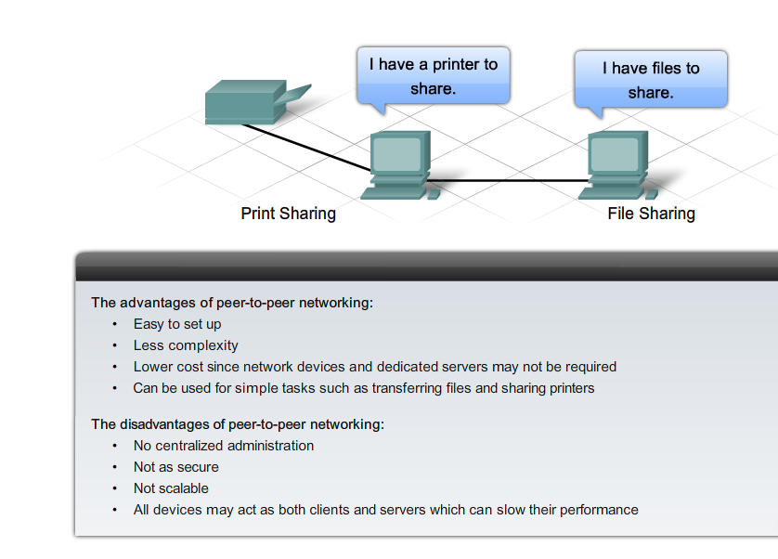
What is a Network ?
Network:
Enable Data Transfer among nodes.
🡪 More than two nodes
i.e. Home Network
Notes:
Section 1.1.2.1

Slide 3
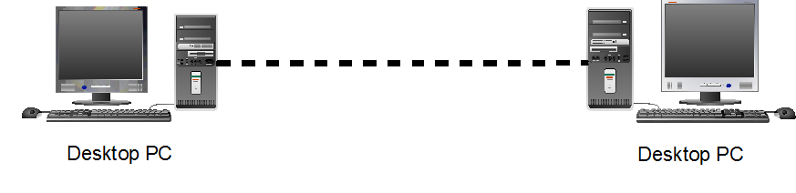
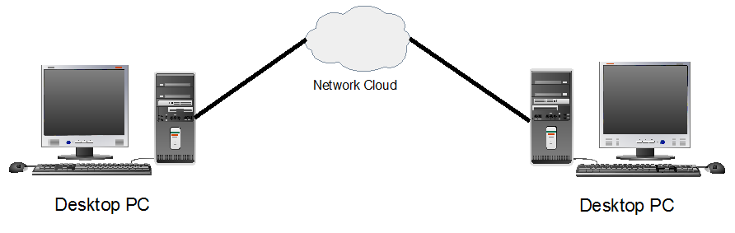
Computer Networks

Slide 4
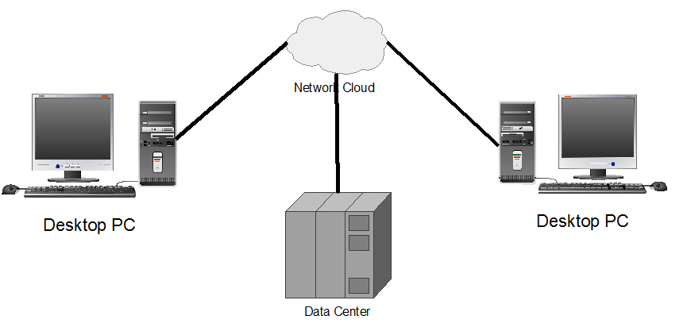
Computer Networks

Slide 5
LANs and WANs Types of Networks
The two most common types of network infrastructures are:
Local Area Network (LAN)
Wide Area Network (WAN).
Other types of networks include:
Metropolitan Area Network (MAN)
Wireless LAN (WLAN)
Storage Area Network (SAN)
Notes:
Section 1.2.2.1

Slide 6
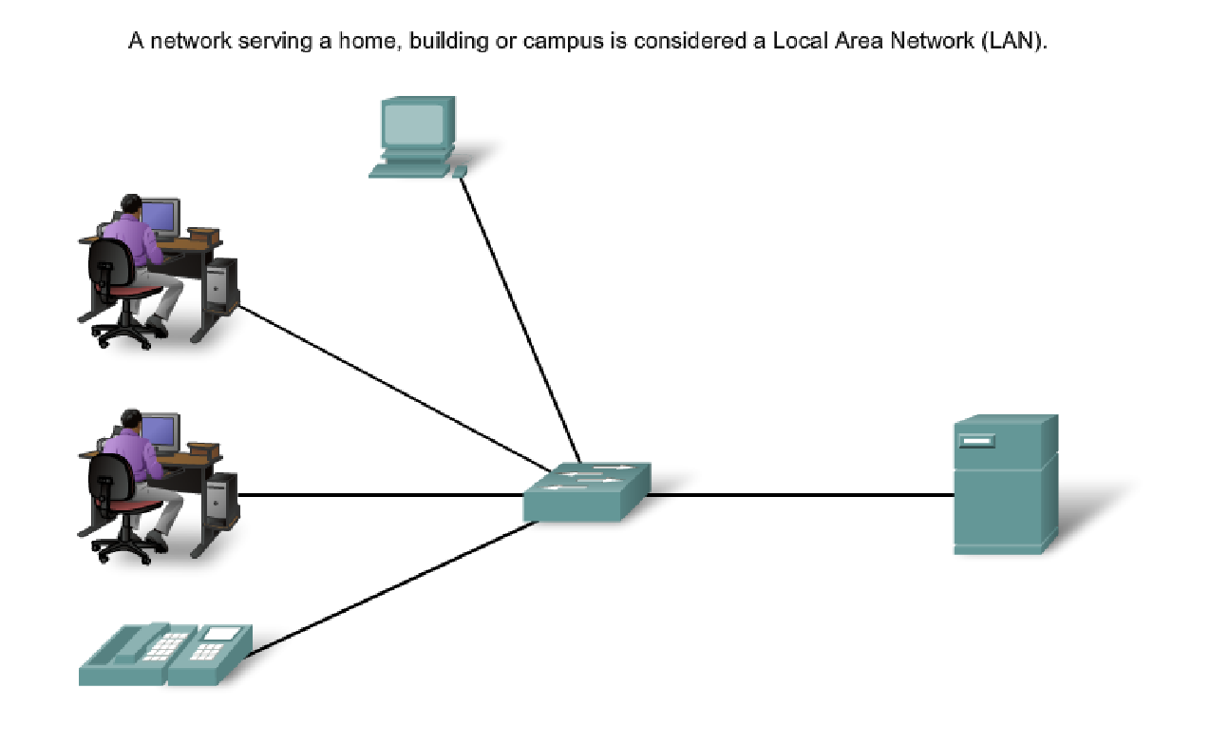
LANs and WANs Local Area Networks (LAN)
Notes:
Section 1.2.2.2

Slide 7
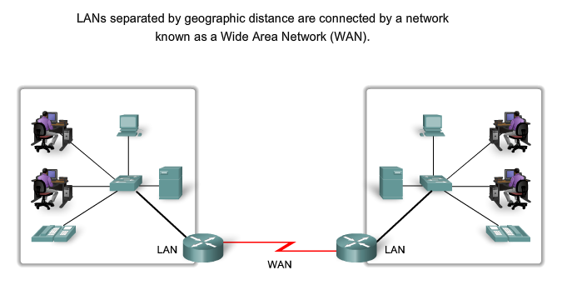
LANs and WANs Wide Area Networks (WAN)
Notes:
Section 1.2.2.3

Slide 8
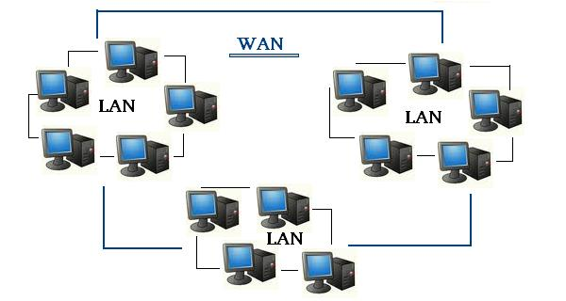
Two very common types of networks

Slide 9
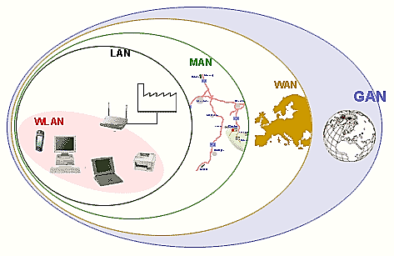
Two very common types of networks
Other types of networks include:
Metropolitan Area Network (MAN)
Wireless LAN (WLAN)
Storage Area Network (SAN)

Slide 10
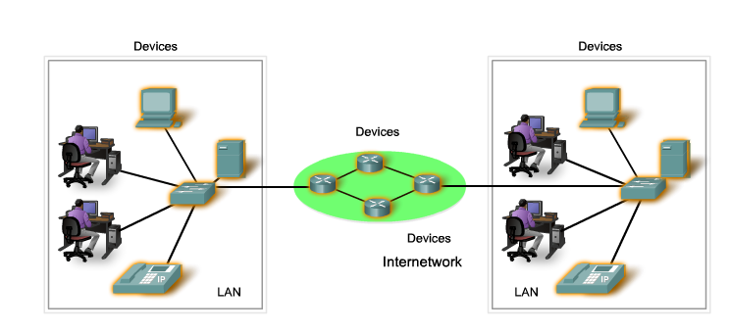
LANs, WANs, and Internets Components of a Network
There are three categories of network components:
Devices
Media
Services
Notes:
Section 1.2.1.1

Slide 11
LANs, WANs, and Internets Components of a Network
Devices
End Device:
Computers (work stations (i.e. Desktop ,Laptops), Servers)
Network printers
VoIP phones
Telepresence endpoint
Security cameras
Mobile handheld devices (such as smartphones, tablets, PDAs, and wireless debit / credit card readers and barcode scanners)
Notes:
Section 1.2.1.1

Slide 12
LANs, WANs, and Internets Components of a Network
Devices
Intermediate Device:
Network Access Devices
(switches, and wireless access points)
Internetworking Devices (Routers)
Security Devices (Firewalls)
Notes:
Section 1.2.1.1

Slide 13
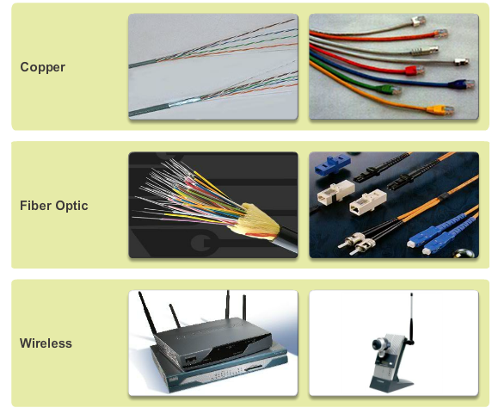
LANs, WANs, and Internets Components of a Network
Notes:
Section 1.2.1.4

Slide 14
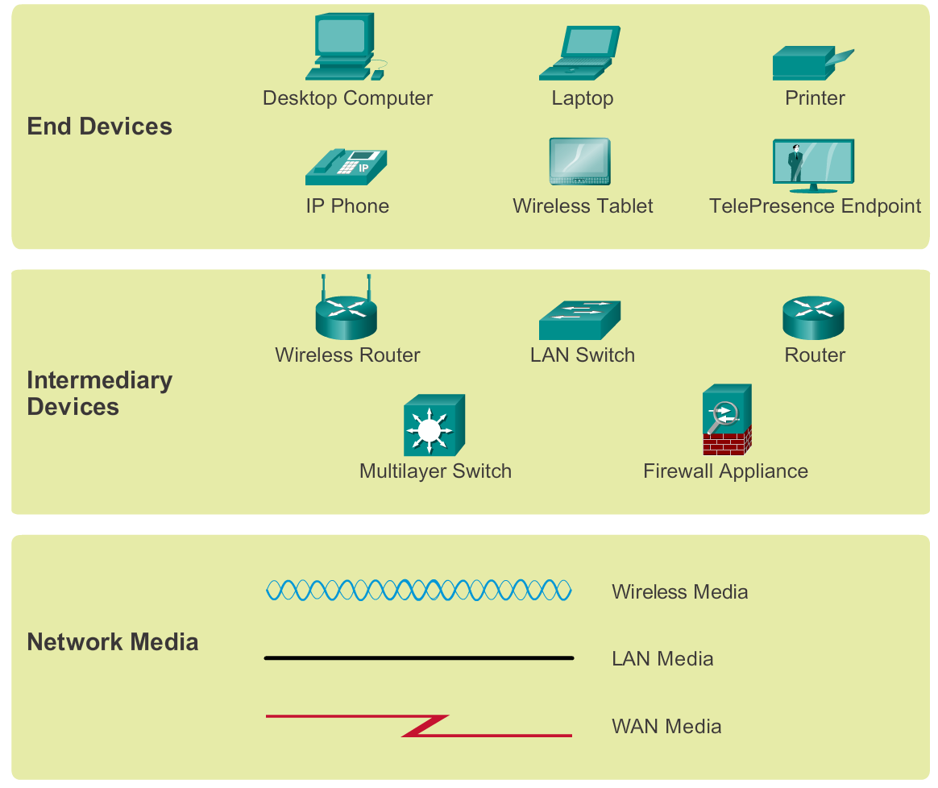
Components of a Network Network Representations
Notes:
Section 1.2.1.5

Slide 15
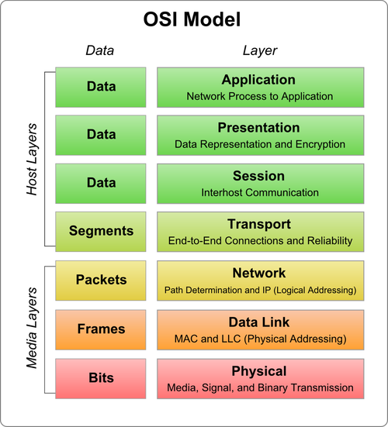
Components of a Network OSI Layer(Open Systems Interconnection)
Notes:
Section 1.2.1.5

Slide 16
Address
Two Type of Address in Computer Networks
1. Physical Address/MAC Address
🡪MAC (Media Access Control) is A Unique Identifier
🡪 48 bits Hexadecimal Address
🡪 Ex. 00:0a:95:9d:68:16
🡪 First Three Octets are Manufacturers ID
Dell: 00-14-22
Cisco: 00-40-96
2. Internet Protocol(IP) Address
Two Types of IP Address:
🡪 IPv4: Internet Protocol version 4
IPv4 Length: 32 bits
🡪 IPv6: Internet Protocol version 6
IPv6 Length: 128 bits
Notes:
Section 1.2.1.5

Slide 17
Internet Protocol (IP)
Type of IP:
🡪 IPv4: Internet Protocol version 4
IPv4 Length: 32 bits
🡪 IPv6: Internet Protocol version 6
IPv6 Length: 128 bits
IPv4 : Dotted Decimal Address
Ex. 192.168.10.0/24
IPv6 : Hexadecimal Address separated by colons (:)
Ex. 2001:0db8:85a3:0000:0000:8a2e:0370:7334/64
Notes:
Section 1.2.1.5

Slide 18
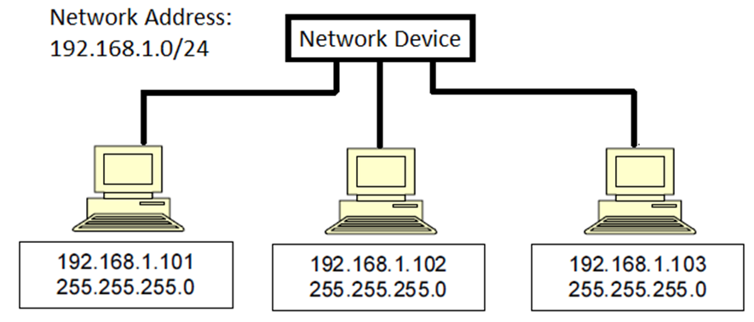
LAN: Local Area Network

Slide 19
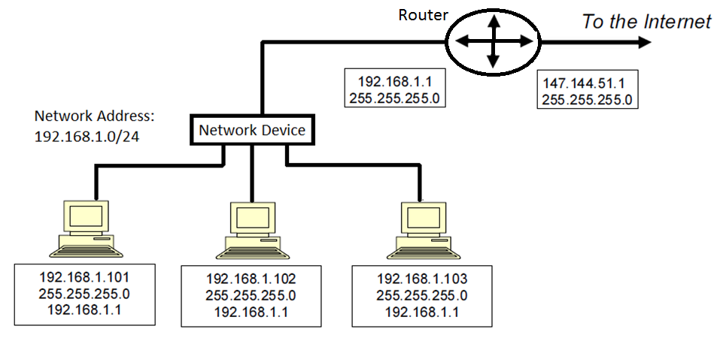
LAN: Local Area Network

